Slide 1

Customer Churn Analysis for Telecom Industry
Using SQL & Machine Learning
Presented By
Project
Tools
Divakar Pal
Data Analytics Internship
SQL, Python, Scikit-learn

Slide 2

Retaining Customers is More Cost-Effective Than Acquiring New Ones
The Challenge
Project Focus
Customer churn is one of the biggest challenges in the
This project focuses on identifying customers who are likely to churn and recommending strategies to reduce churn rate. By leveraging data-driven insights, we aim to transform reactive measures into proactive retention strategies.
telecom industry.
Retention >
Acquisition
Acquiring a new customer can cost up to 5x more than
retaining an existing one.

Slide 3




Project Objectives: Analyze, Predict, and Recommend
Analyze
Segment
Deep dive into customer data to understand behavior and patterns.
Identify
Build
Categorize customers based on their probability of churning.
Recommend
Pinpoint key factors and drivers that significantly affect churn.
Develop a predictive machine learning model for churn forecasting.
Provide actionable business strategies for customer retention.

Slide 4



Dataset Overview: 7,043 Customers and 21 Features
Quick Stats
Key Features (21 Total)
Dataset Name
Telco Customer Churn
Tenure
Monthly Charges
Total Records
Contract Type
7,043
Internet Service
Payment Method
Target Variable
Churn (Yes/No)
The dataset includes demographic information, account details, and service usage patterns to predict customer attrition.

Slide 5

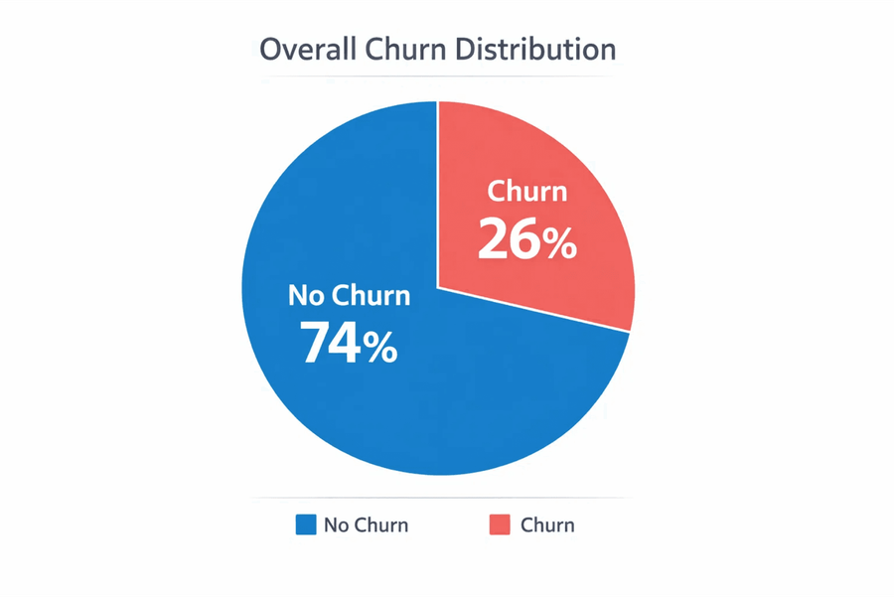
SQL Analysis Reveals Key Churn Drivers
Overall Churn Rate
~26%
Month-to-month contracts show the highest churn propensity.
Customers with low tenure are significantly more likely to leave.
Higher monthly charges directly correlate with increased churn risk.
Electronic check users churn more frequently than other payment methods.

Slide 6

Exploratory Data Analysis (EDA) Insights
Distribution
Tenure
Class Imbalance
Early Attrition
The dataset shows a significant imbalance between churn and non-churn customers, requiring careful handling during model training to avoid bias.
Customers with short tenure (less than 6 months) exhibit the highest churn rates, indicating a critical onboarding period.
Contracts
Charges
Contract Correlation
Pricing Sensitivity
Month-to-month contracts are the strongest predictor of churn, while long-term contracts significantly improve retention.
A direct correlation exists between high monthly charges and churn probability, suggesting price sensitivity among at-risk segments.

Slide 7
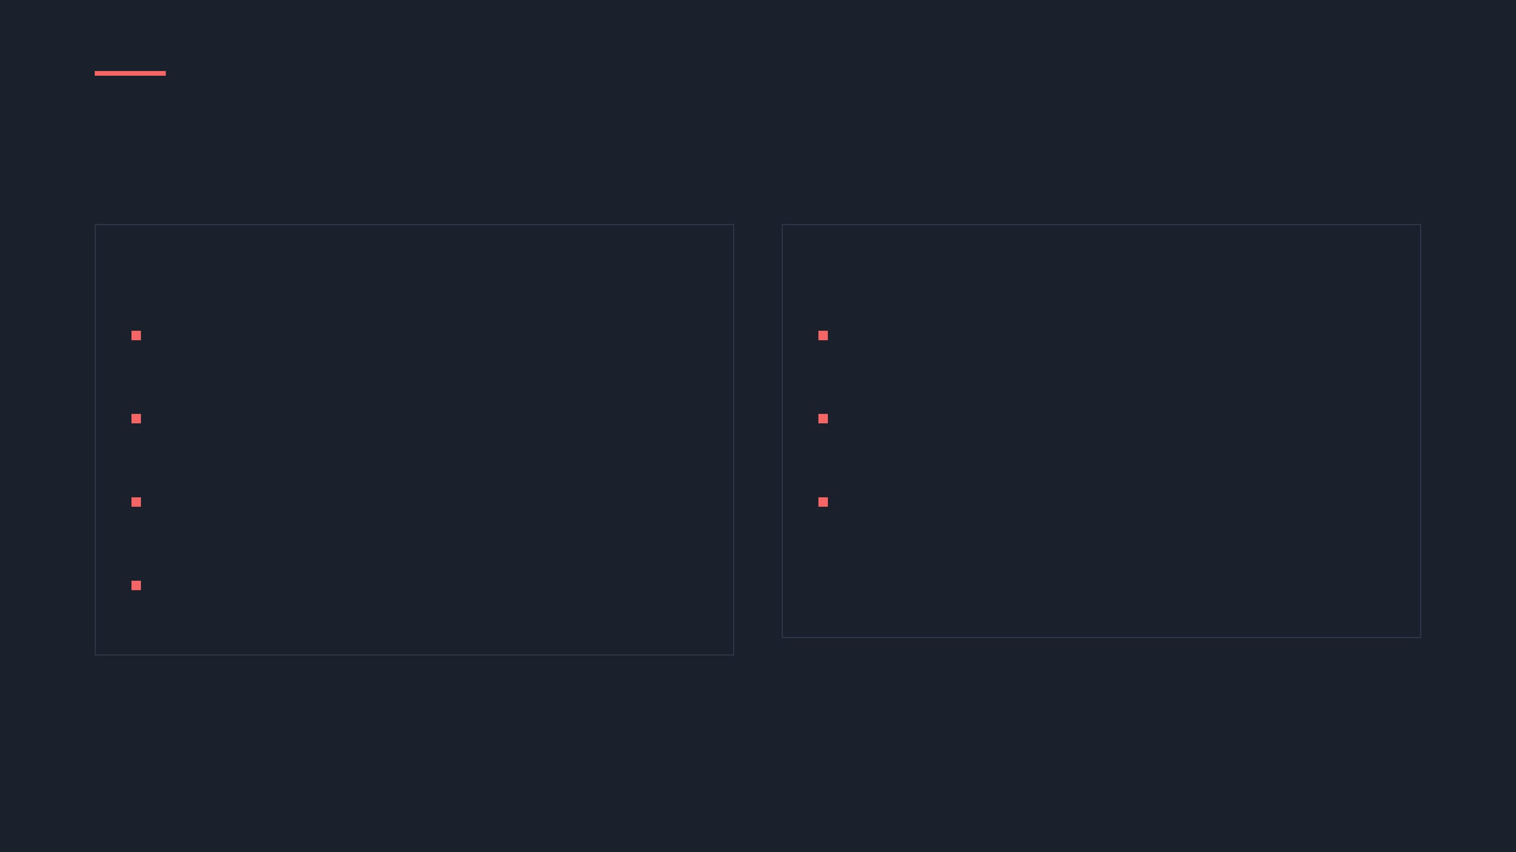


Logistic Regression Model for Binary Classification
Model Building Process
Why Logistic Regression?
Data Cleaning: Handling missing values and outliers in the Telco dataset.
Binary Classification: Perfectly suited for the Yes/No nature of customer churn.
Feature Encoding: Converting categorical variables into numerical formats for the model.
Interpretability: Provides clear insights into how each feature impacts churn probability.
Train-Test Split: Partitioning data into 80% training and 20% testing sets.
Efficiency: Computationally inexpensive and fast to train on the 7,043 records.
Model Training: Fitting the Logistic Regression algorithm to the training data.

Slide 8

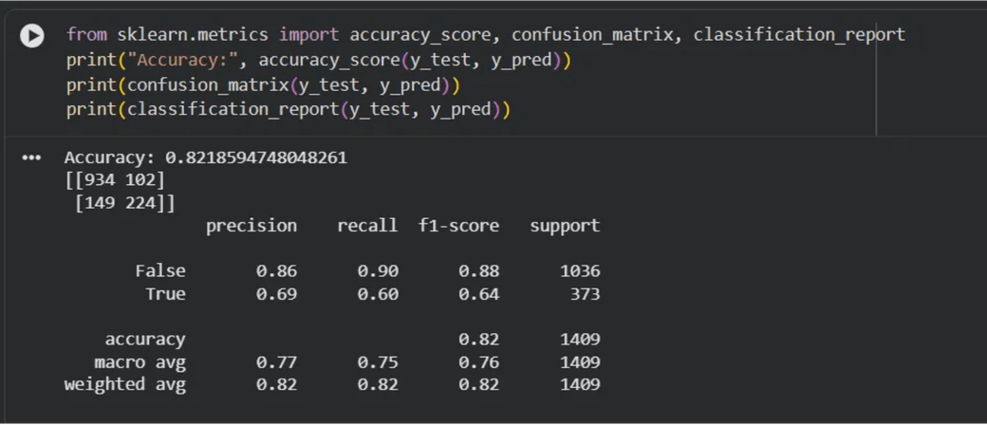
Model Achieves 82.19% Accuracy
Overall Model Accuracy
82.19%
Key Evaluation Metrics
Precision (Churn: True)
0.69
Recall (Churn: True)
0.60
F1-Score (Churn: True)
0.64

Slide 9

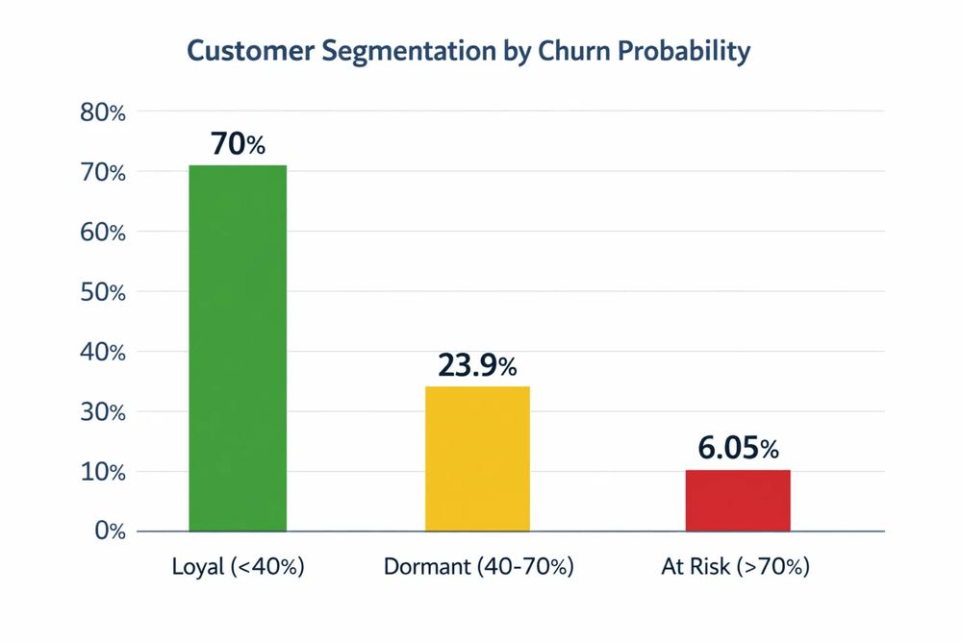
Customer Segmentation for Targeted Retention
Loyal Customers
70%
Churn Probability: < 40%
Dormant Customers
23.9%
Churn Probability: 40% – 70%
At Risk Customers
6.05%
Churn Probability: > 70%
Segmentation allows for prioritized intervention, focusing high-touch retention efforts on the 6.05% of customers most likely to leave.

Slide 10

Actionable Business Recommendations & Conclusion
At Risk Customers
Dormant Customers
Loyal Customers
Offer targeted discounts
Re-engagement campaigns
Loyalty reward programs
Promote long-term contracts
Exclusive bundle offers
Referral incentives
Provide personalized support
Feature update notifications
Early access to new services
"By using data analysis and machine learning, we identified key churn drivers and provided actionable strategies to reduce customer attrition, ultimately driving long-term business growth and stability."

